Slide 1
CH1.1 Machine Learning Basics
AI/Machine Learning/Deep Learning
Applications in Computer Vision
NLP Integrated Applications
Multimodal Applications

Slide 2
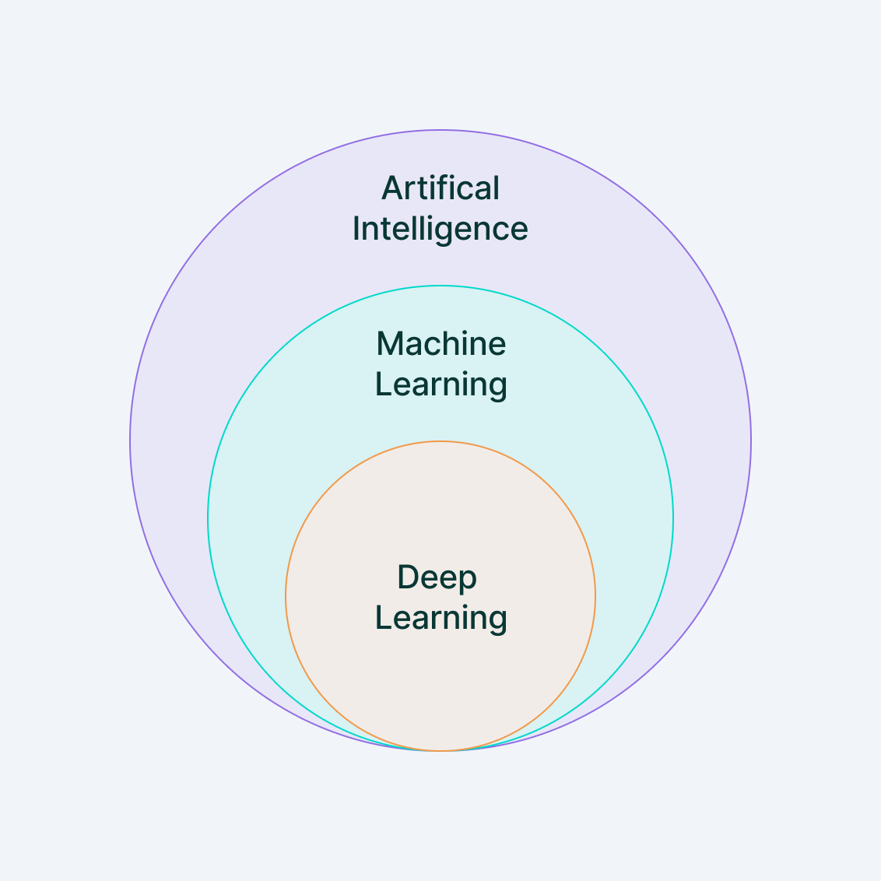
AI/Machine Learning/Deep Learning
Artificial intelligence(AI) is a field of computer science that focuses on the development of intelligent computer systems that are able to perform tasks and make decisions that would typically require human intelligence, such as learning, problem-solving, and decision-making
Machine Learning(ML) is an application of AI that enables systems to learn and improve from experience without being explicitly programmed.The goal of machine learning is to develop models that can generalize well to new, unseen data.
Deep Learning(DL) is a type of machine learning that involves the use of artificial neural networks with multiple layers of interconnected nodes. It is a highly advanced form of machine learning that allows for the creation of complex models that can process and analyze large amounts of data in order to make predictions or decisions.

Slide 3
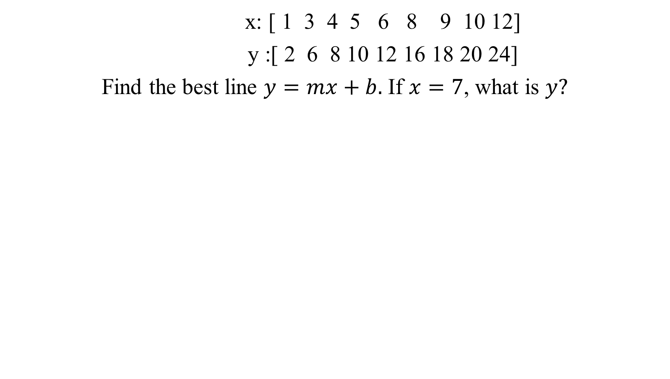
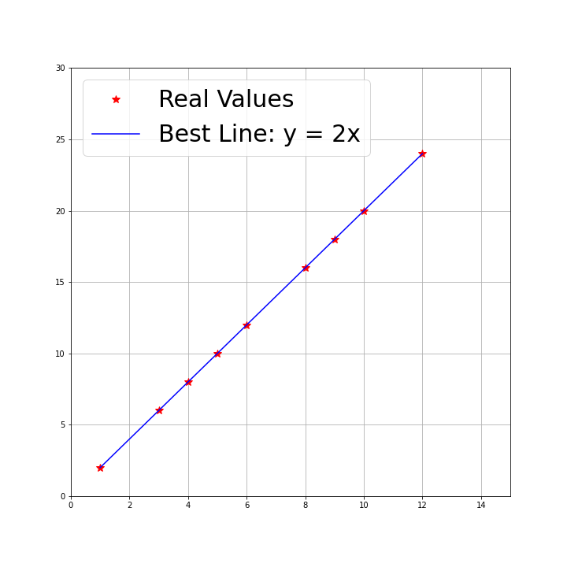
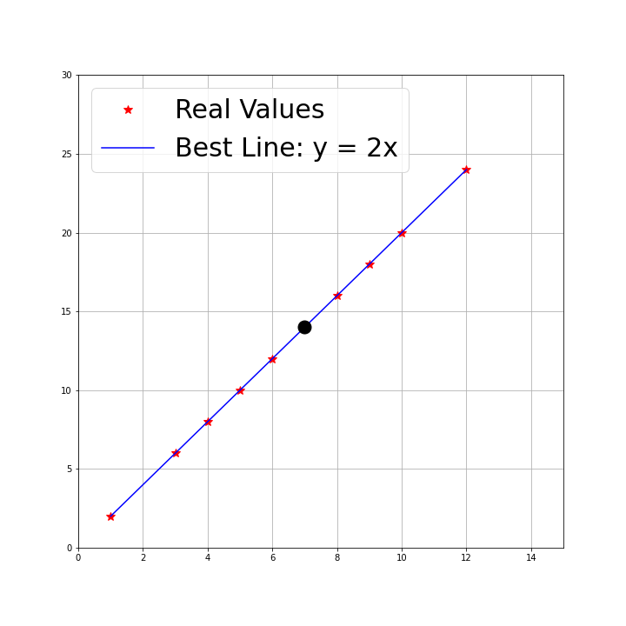

Slide 4
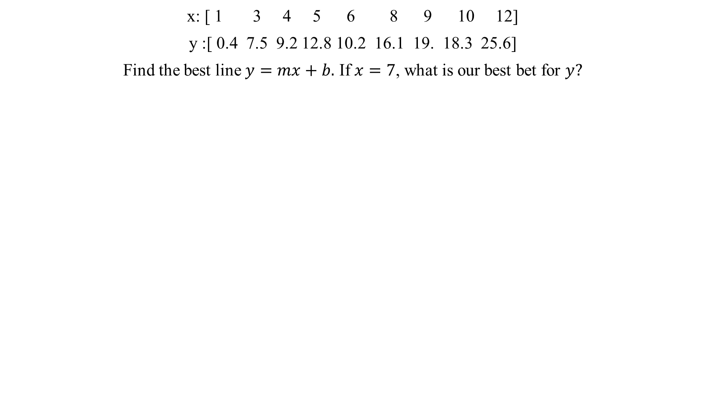
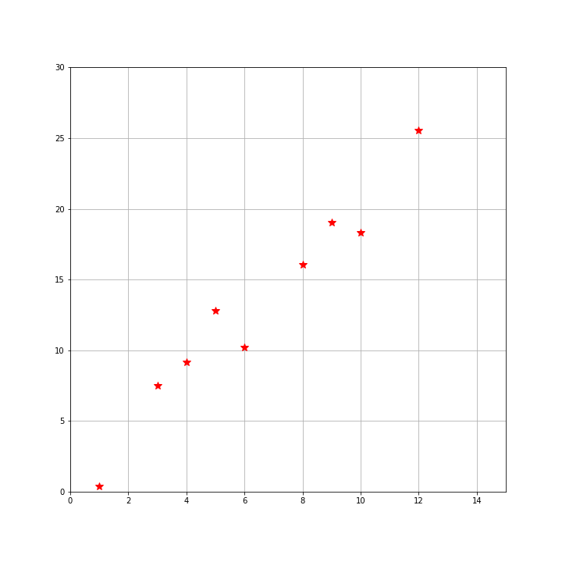
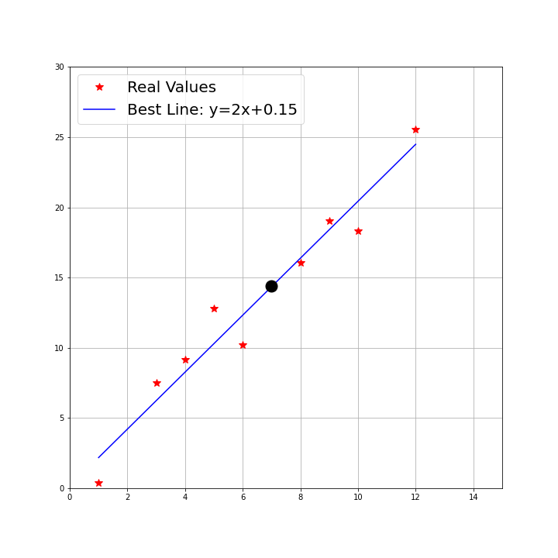

Slide 5
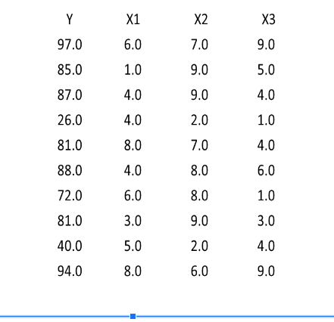
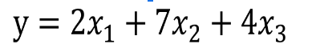

Slide 6

source: https://www.cognub.com/

Slide 7
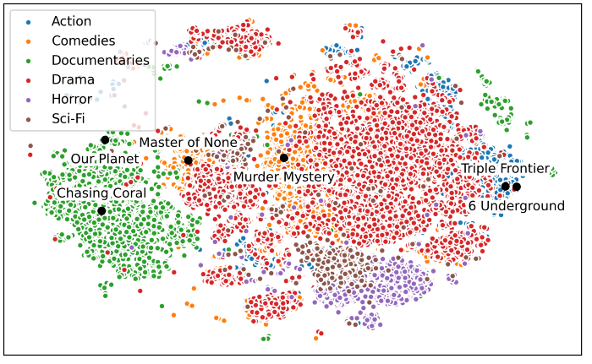
Unsupervised Learning - Clustering
https://netflixtechblog.com/supporting-content-decision-makers-with-machine-learning-995b7b76006f

Slide 8
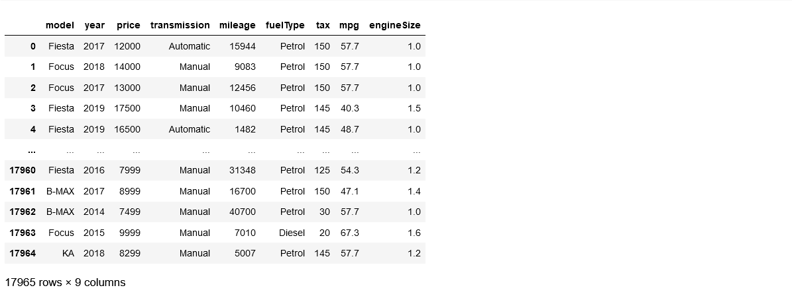
Supervised Learning - Regression

Slide 9
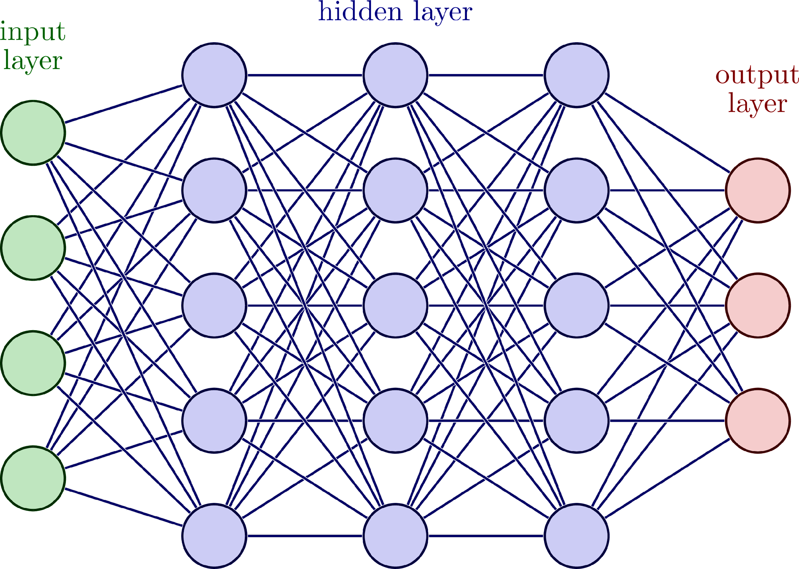
Deep Learning Framework
INPUT
MODEL
(FUNCTION)
(NEURAL NETWORK)
OUTPUT

Slide 10
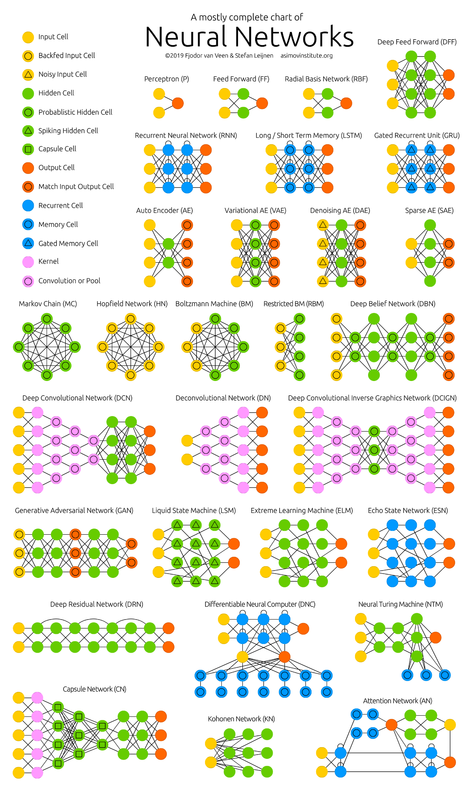
https://www.asimovinstitute.org/neural-network-zoo/

Slide 11
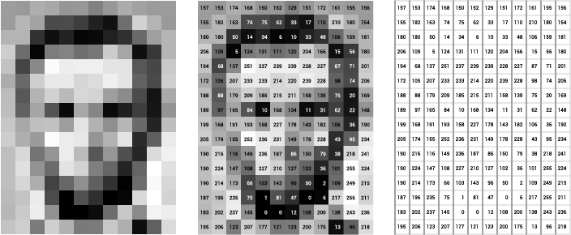
What is an image?
Source: https://ai.stanford.edu/~syyeung/cvweb/tutorial1.html

Slide 12
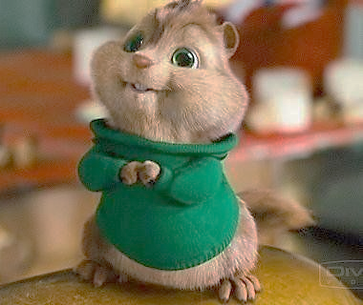
INPUT: IMAGE
OUTPUT: VECTOR
NEURAL NETWORK
Chipmunk: 0.81
Squirrel: 0.13
Moose: 0.5
Human: 0.1
160,000 parameters
How many data points are there?
How many parameters should my model have? A lot…

Slide 13
Some Computer Vision Tasks
Image Classification
Applications etc…..
Object Detection
Object Segmentation
Image Colorization
Image Reconstruction
Image Super-Resolution
Thousand of others….

Slide 14
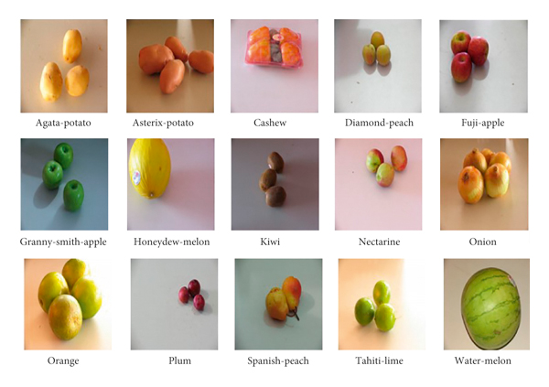
Image Classification: image→list
https://www.hindawi.com/journals/mpe/2022/9210947/

Slide 15
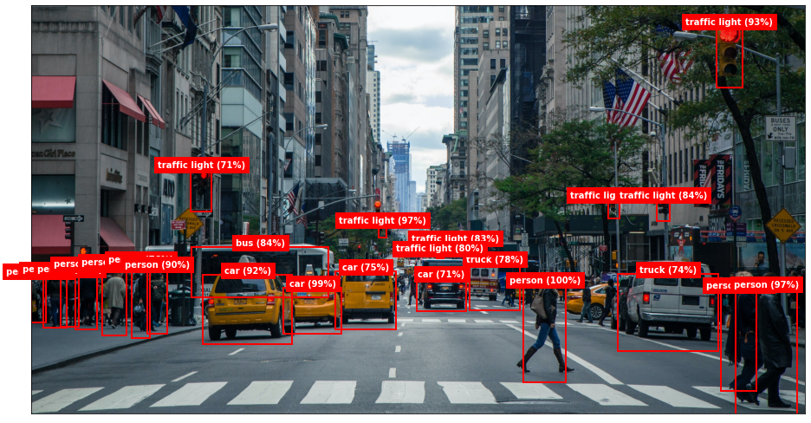
Object Detection: image→bounding box
https://www.atmosera.com/blog/object-detection/

Slide 16
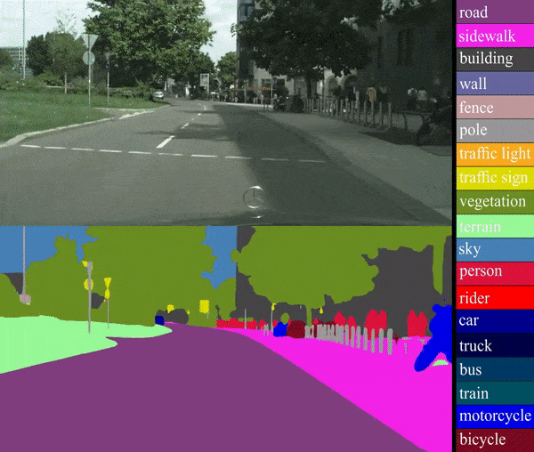
Object Segmentation: image→image
https://www.zignite.io/post/image-segmentation-and-classification-using-deep-learning

Slide 17
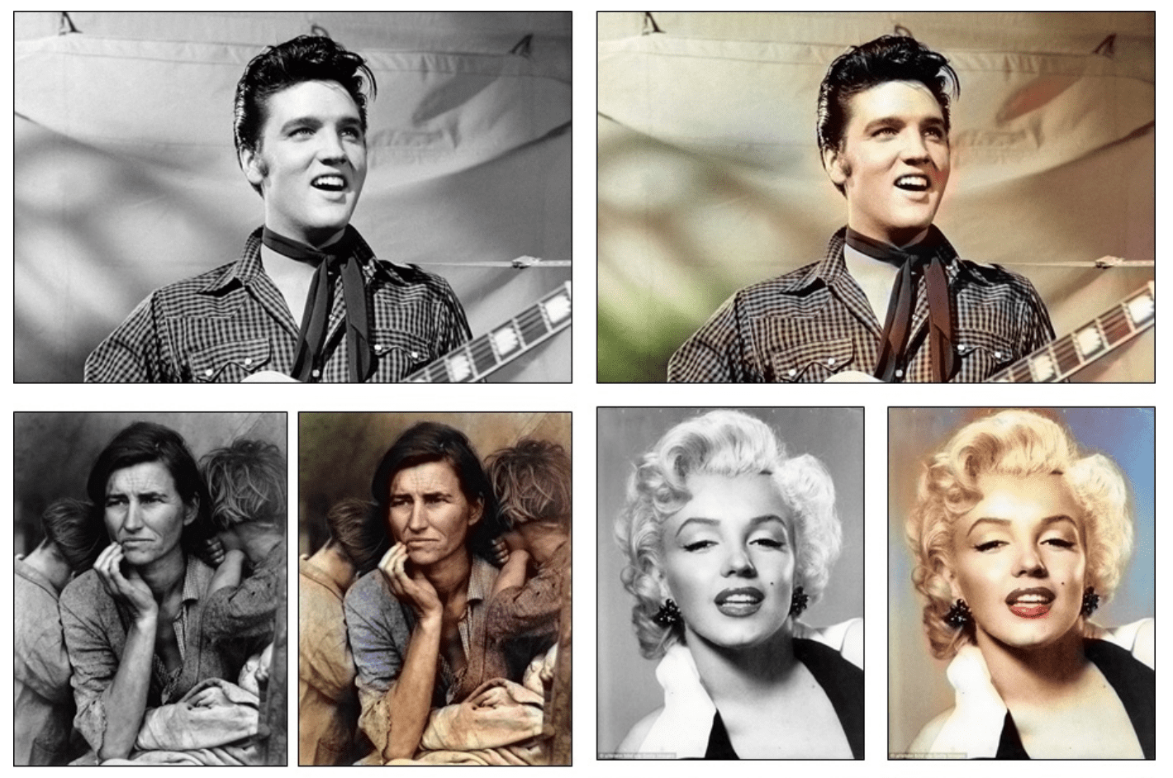
Image Colorization: image→image
https://richzhang.github.io/colorization/

Slide 18
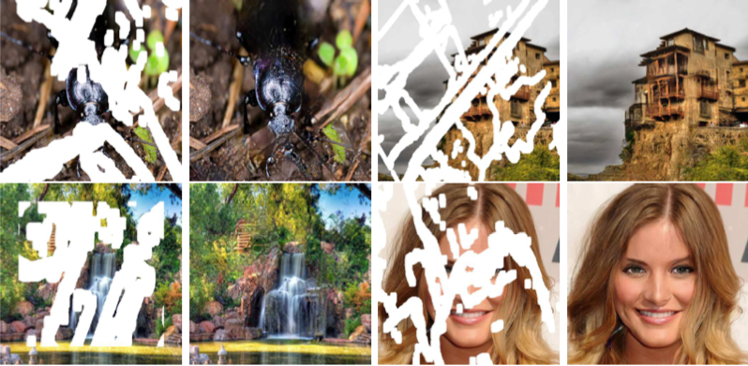
Image Reconstruction: image→image
https://arxiv.org/pdf/1804.07723.pdf

Slide 19
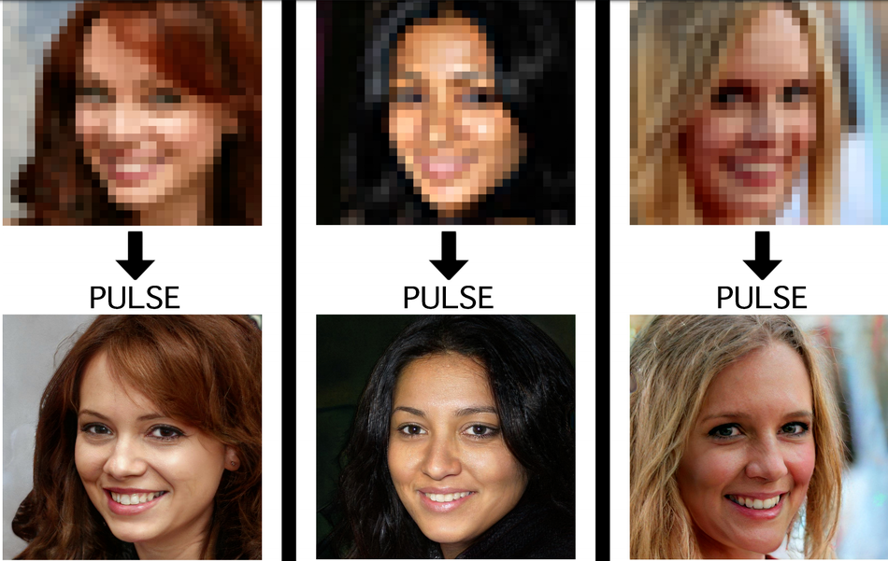
Image Super Resolution
https://arxiv.org/pdf/2003.03808v1.pdf

Slide 20
NLP: Natural Language Processing
INPUT: “hate this movie, what a waste of time”
Sentiment Analysis
Text Classification
Text Extraction
Machine Translation/Transcription
Text Summarization
Auto-Correction
Speech Recognition
MODEL
OUTPUT: Positive: 0.02
Negative: 0.98

Slide 21
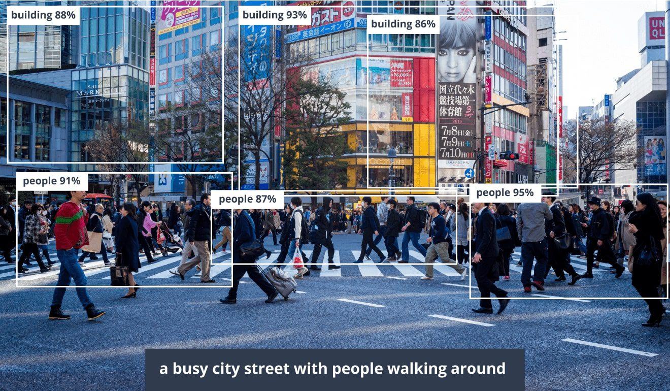
Image Captioning
INPUT: IMAGE
MODEL
INPUT: TEXT

Slide 22
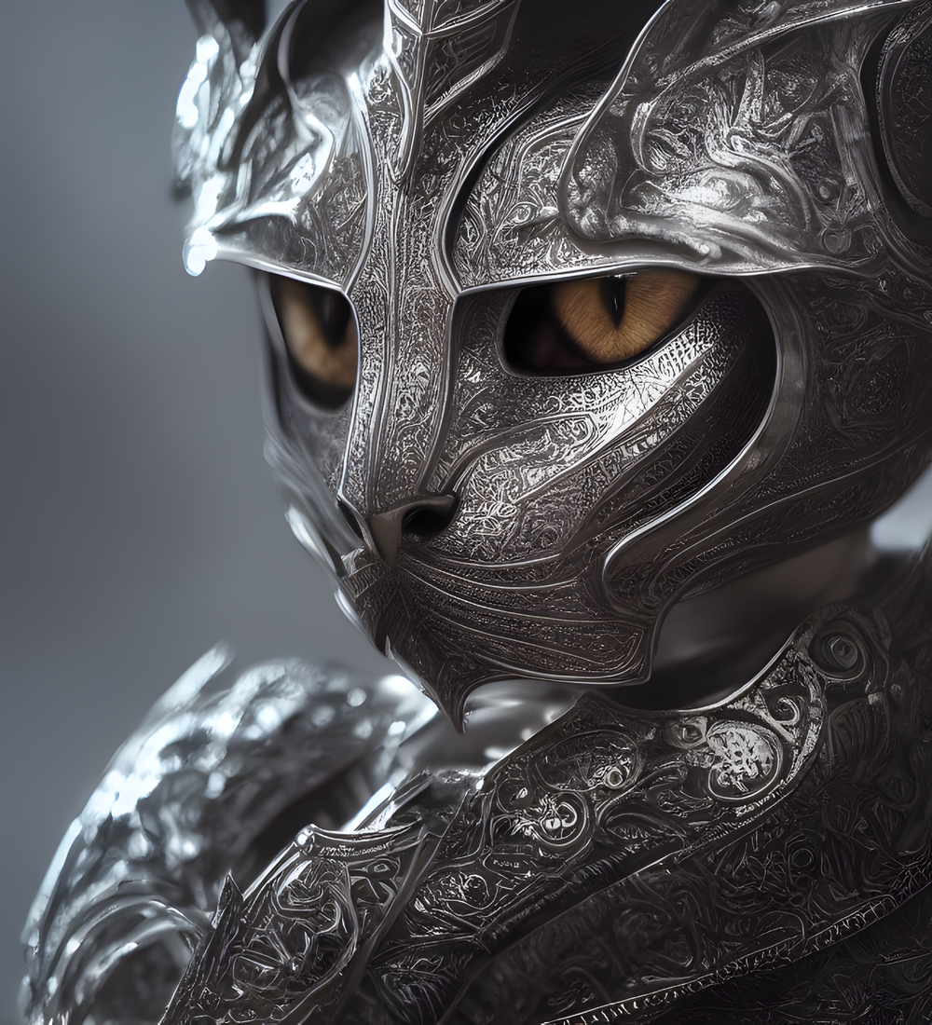
Text to Image Models
Prompt: kneeling cat knight, portrait, finely detailed armor, intricate design, silver, silk, cinematic lighting, 4k
MODEL
https://www.jousefmurad.com/ai/a-primer-on-stable-diffusion/

Slide 23
HOMEWORK
Look around to find an interesting application you can work on.
I posted list of applications we can work on in our colab space.

